Slide 1
IERG 4210 Web Programming and Security
2017-2018 Term 1
Tutorial 3
By Dong Shuaike
Notes:
1

Slide 2
Outline
Assignment phase 2A
Apply for AWS educate
Create EC2 instance
Set up working environment
Do basic security configuration
IERG 4210 Tutorial 3
Notes:
2

Slide 3
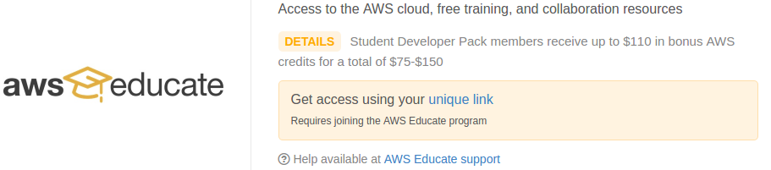
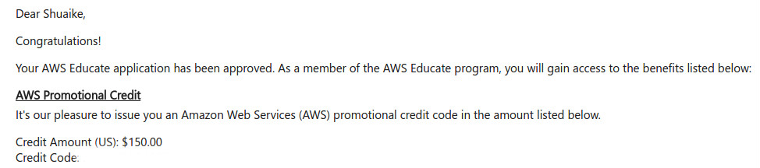
Amazon Web Service
Check your AWS ID in AWS console →My Account → Account Settings
(recommended) Apply for aws educate
First Create your AWS account
Enter from github student develop pack.
Several minutes or hours may be needed.
will receive two emails if successful.
Second email will tell you how to use promo code.
(optional) Apply for AWS Free Usage Tier
A credit card needed (Free for a year)
Website: http://aws.amazon.com/free/
Tools
If you’re using Windows, you need Putty and Puttygen ( http://www.chiark.greenend.org.uk/~sgtatham/putty/download.html )
If you’re using Linux or macOS, ssh is enough.
IERG 4210 Tutorial 3

Slide 4
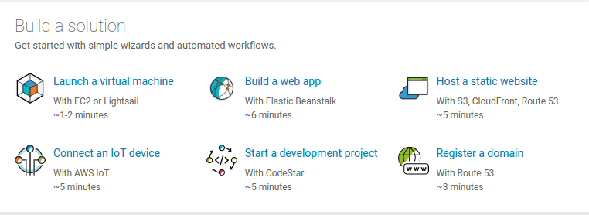
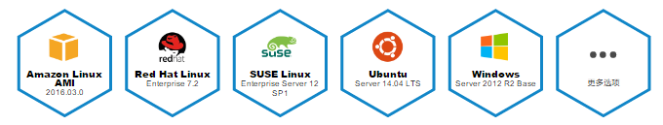
Amazon Web Service
Create a EC2 virtual server
Name your instance
Choose the image you like.
Amazon Linux AMI is recommended. (Some of the environment has been established.) But you have other choices.
The Amazon Linux AMI is an EBS-backed, AWS-supported image. The default image includes AWS command line tools, Python, Ruby, Perl, and Java. The repositories include Docker, PHP, MySQL, PostgreSQL, and other packages.
IERG 4210 Tutorial 3

Slide 5
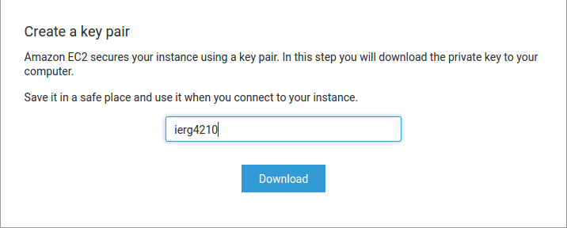
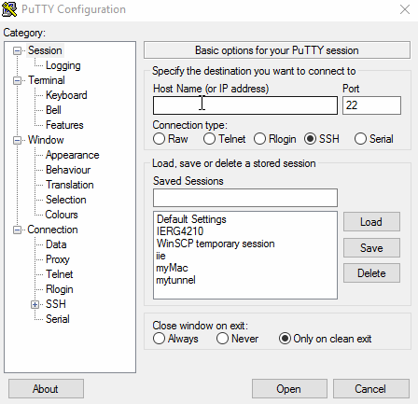
Amazon Web Service
Create and download the private key (xxxx.pem)
Something about public-key cryptography.
Using putty and puttygen to login the remote server. (for windows user)
(puttygen) Import the xxx.pem and save as private key.
Then you have a xxx.ppk file.
Login with putty.
Input the Host name (ec2-user@xxx)
Use private key(xxx.ppk) to login.
Save your session.
IERG 4210 Tutorial 3
Notes:
Public-key cryptography is also called asymmetric cryptography. In this process, the encryption and decryption need a pair of keys – called public key and private key. Given you one of them two, you can not defer the other. It is safer than the password because the latter is too short. In our case, AWS generates a pair of key, and send the private key to you, then it is your private key. At the same time, AWS stored your public key on the machine.
5

Slide 6

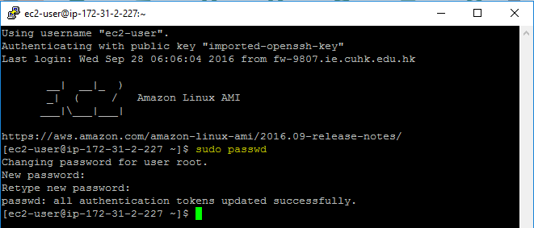
Amazon Web Service
Note:
Your private key must be protected!!! (set proper permission for it.)
chmod 400 ierg4210_2017.pem
Or you will NOT be able to login
Then ssh –i ierg4210_2017.pem ec2-user@[public ipv4 DNS]
Remember to set password for user root (first thing to do when you login)
sudo passwd
Check it in your console
IERG 4210 Tutorial 3

Slide 7
Set up Environment
Install Apache and PHP (Amazon Linux AMI)
Command: sudo yum install httpd php php-devel
SQLite has already been installed.
You may also install MySQL instead of SQLite.
more famous as “LAMP” – Linux, Apache, MySQL, PHP
Command: sudo yum install httpd mysql-server php php-devel php-mysql
Install Apache and PHP (Ubuntu 14.04)
Command:
sudo apt-get install apache2 apache2-doc
sudo apt-get install php5 libapache2-mod-php5
sudo service apache2 restart
sudo apt-get install mysql-server mysql-client
Reference:
http://blog.csdn.net/tecn14/article/details/27515241
IERG 4210 Tutorial 3

Slide 8
Set up Environment
Configure the Apache configuration file
httpd.conf
Location: /etc/httpd/conf/httpd.conf
Add this LoadModule php5_module modules/libphp5.so in httpd.conf
It’s good for you to read and know about the whole file.
If you don’t know why and how to change it, just leave it unchanged.
Some parameters of httpd.conf
ServerRoot “/etc/httpd” : define the root folder of Apache service.
KeepAlive on: whether or not to allow persistent connections.
MaxKeepAliveRequests 500: Max number of requests during a persistent connection.
Listen 80: Apache server will listen to port 80 for request.
DocumentRoot “/var/www/html”: Where your webpages are placed.
Noted: All files under this folder are public accessible.
Some reference:
http://ahmed.amayem.com/enabling-php-in-apache-on-linux-centos-6-by-loading-the-module-in-httpd-conf/ (en)
IERG 4210 Tutorial 3

Slide 9
Set up Environment
Similar to Apache, you can modify the configuration file of php.
Location: /etc/php.ini
file_uploads = On : whether or not to allow http file uploads
display_errors = Off : whether the error message will be displayed on the screen
display_startup_errors = Off : whether the error message in the initialization process will be showed
log_errors = On :whether will the error messages be logged
Start up the Apache service
sudo service httpd start
Reference: http://php.net/manual/zh/ini.list.php
IERG 4210 Tutorial 3

Slide 10
Set up Environment
Set the firewall to open the port 80 so that your website can be accessed.
Click the mouse and see the gif.
You may add rule “HTTPS” (open port 443 only after you are ready to provide HTTPS service).
IERG 4210 Tutorial 3

Slide 11
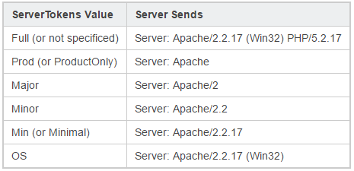
Apply Security Configurations
What?
Apply proper firewall settings at Amazon: block all ports but 22, 80 and 443.
Apply proper updates for the server software packages in a regular manner.
Hide the versions of OS, Apache and PHP in HTTP response headers.
Do not display any PHP warnings and errors to the end users.
Disable directory index in Apache.
Why?
How?
Amazon Web Service Console
vim /etc/httpd/conf/httpd.conf
vim /etc/php.ini
IERG 4210 Tutorial 3

Slide 12
Uploading your Website
Upload your website files to $DocumentRoot: /var/www/html in our case.
Tools:
winSCP/FileZilla for Windows
Scp/Sftp for Linux/Mac
Using “sudo” to get the superuser privilege.
Let’s see whether we can access our website.
Open the browser, type in the ip address( not private ip address ) and your main page, then press enter.
IERG 4210 Tutorial 3

Slide 13
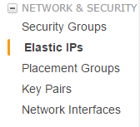
Assignment phase 2A
1. Applying Amazon EC2 virtual machine.
2. Apply security configuration on the web server (Note: you should block port 443 until HTTPS is ready.)
3. Attach an Elastic IP for your new server and submit the IP address in README. Then we will assign a domain name for you.
How? Similar to the process of setting firewall.
After you have allocated and associated the elastic ip with your instance, then you can login with the elastic ip.
Why do we need elastic IP? I’d love to see your answer in README
4. Upload your website to the server and visit it
Important: DO NOT LEAK YOUR PRIVATE KEY!
(This is why I didn’t upload a puttgen gif)
IERG 4210 Tutorial 3
Notes:
13

Slide 14
Questions of phase 1
How to state that I have finished phase 1?
We will check the timestamp of your lasted push operation.
Do I need to implement the function of add-to-cart in phase 1?
No, in phase 2B and phase 3.
What is Master branch used for?
Master should always keep a whole copy of your ready-to-visit website.
We will check your Master branch after phase 2.
Do I need to implement all the categories/products now?
No, just show me your website can work. The user-friendly UI will be considered in last phase.
Reminder:
1. For some minor questions, we may post them as open issues in your repository.
2. You can share code snippet using JSFiddle(for JS code) and github Gists.
3. You are welcomed to post your problems in our Facebook Group.
IERG 4210 Tutorial 3

